Slide 1
Pyregence Fuel Models

Slide 2
Overview
Litter+duff:
  Sample Depth
FWD (1-100h)
  Sample tally
  Particle diameter (0-7.62)
CWD
  Sample tally
  Particle diameter (>7.62)
Understory veg
  Veg presence (T/F)
  Veg height (# occupied strata)
Saplings
  Plot tally
Trees
  Plot tally

Slide 3
Litter + Duff description
Statistical model
Fuelbed simulation
Neg. Binomial response
  Depth at sample point
Fixed effects
  Drought mortality level
Random effects
  Gaussian process (fine-scale, spatial)
  Plot (coarse, aspatial)
Simulate responses (litter+duff depths) on 0.5m resolution grid in 1 or 2 dimensions
Use van Wagtendonk allometric eqns to map from depth (cm) to biomass (Mg/ha)

Slide 4
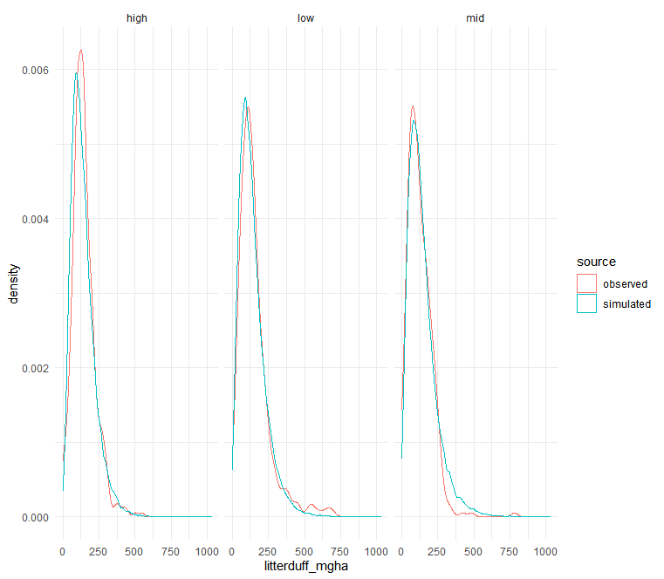
Litter+duff reality check
Subsample level
Rounding depth to nearest integer to use NB response
Litter+duff depth combined

Slide 5
FWD description
Statistical Models
Fuelbed simulation
Tally at sample
  Neg. Binomial response
    Tally on 1m subtransect
  Fixed effects
    Drought mortality level
  Random effects
    Gaussian process (fine-scale, spatial)
    Plot (coarse, aspatial)
Particle size
  Inv-Gamma response
  Truncated to [0, 7.62]
  Fixed effects
    Drought mortality level
Simulate tally of 1-100h on 1m resolution grid in 1 or 2 dimensions
For each simulated particle, simulate a diameter, then bin them into 1h, 10h, 100h size classes
  Arbitrary size bins possible
Use van Wagtendonk allometric eqns to map from tally in size class (#) to biomass (Mg/ha)

Slide 6
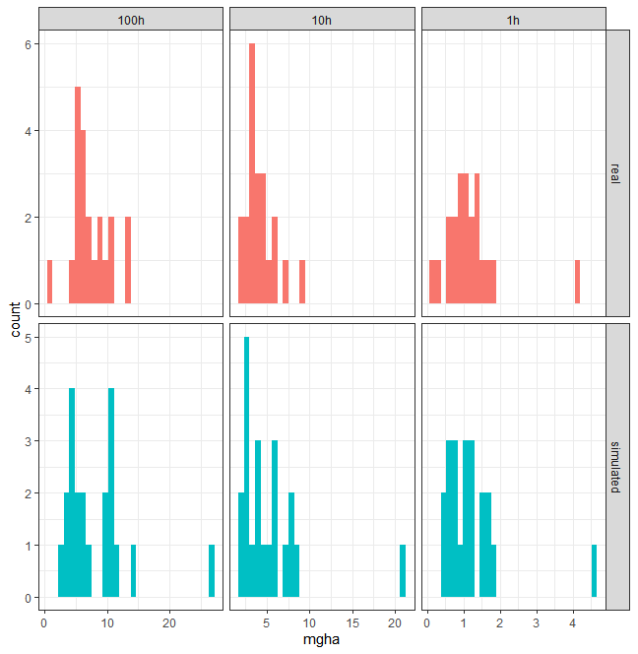
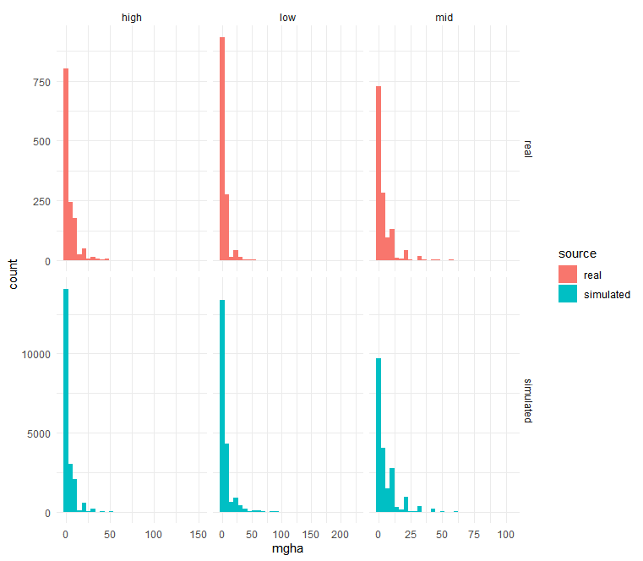
FWD reality check
Plot-level means
Subsample level

Slide 7
CWD description
Statistical Models
Fuelbed simulation
Tally at sample
  Poisson response
    Tally on 1m subtransect
    NB failed to fit
  Fixed effects
    Drought mortality level
  Random effects
    Gaussian process (fine-scale, spatial)
    Transect (orientation bias)
    Plot (coarse, aspatial)
Particle size
  Inv-Gamma response
  Truncated to [>7.62]
  Parameters vary by drought mortality level
Simulate tally of CWD on 1m resolution grid in 1 or 2 dimensions
For each simulated particle, simulate a diameter
Use van Wagtendonk allometric eqns to map from sum of squared diameters (cm2) to biomass (Mg/ha)

Slide 8
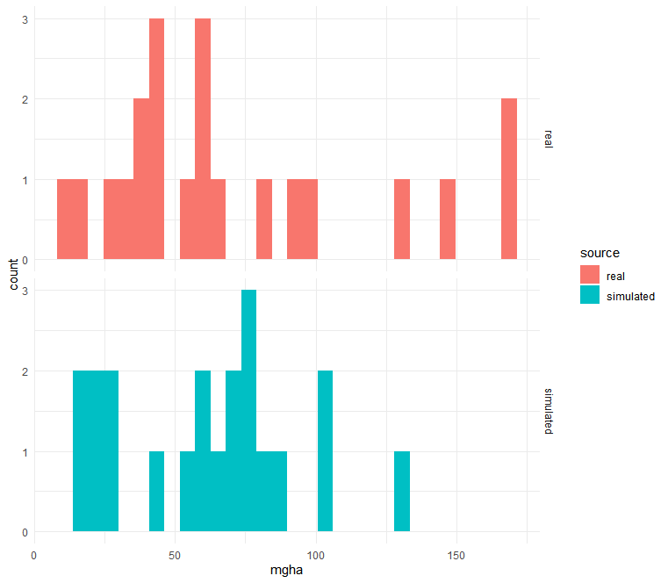
CWD reality check

Slide 9
Understory veg description
Statistical Model
Fuelbed simulation
Presence/Absence of vegetation at sample
  Bernoulli response
  Fixed effects
    Drought mortality level
  Random effects
    Gaussian process (fine-scale, spatial)
    Plot (coarse, aspatial)
Count of occupied strata at sample
  Binomial response
    N occupied 0.25m strata, counting up from ground level to a max of 3.5m
  Fixed effects
    Drought mortality level
  Random effects
    Gaussian process (fine-scale, spatial)
    Plot (coarse, aspatial)
Simulate vegetation presence on 0.5m resolution grid in 1 or 2 dimensions
Simulate vegetation height on identical grid, filter to only points where veg is present
  0.5m =~ mean crown diameter in McGinnis sample
Assume each pixel with height >0m is an individual plant with crown volume = height*pi*(0.25^2)
Use generic McGinnis equation for biomass ~ crown vol
Assume each pixel with height >0m is an individual plant with diameter = 0.56m and height h
  Crown area = 1 pixel = 0.25m2; similar to midpoint crown area in McGinnis of 0.3m2 from midpoint diameter of 0.62m
Use generic McGinnis equation for biomass ~ diameter + height
Divide total biomass into the occupied 0.25m strata

Slide 10
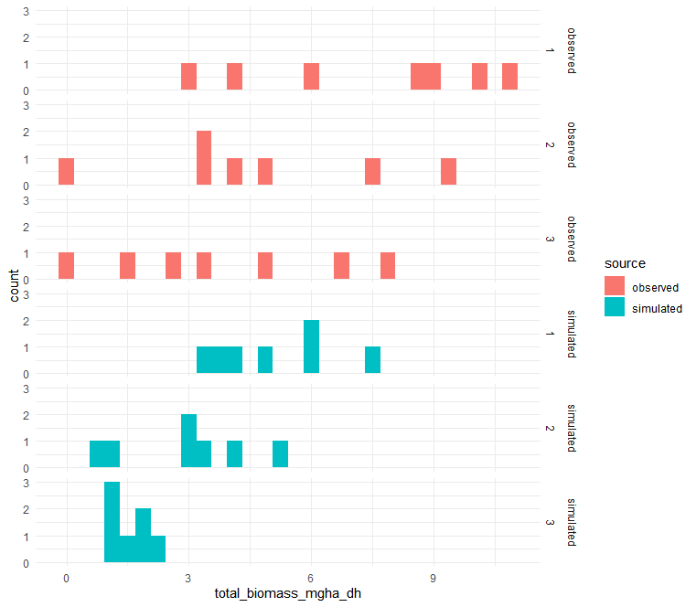
Understory veg reality check

Slide 11
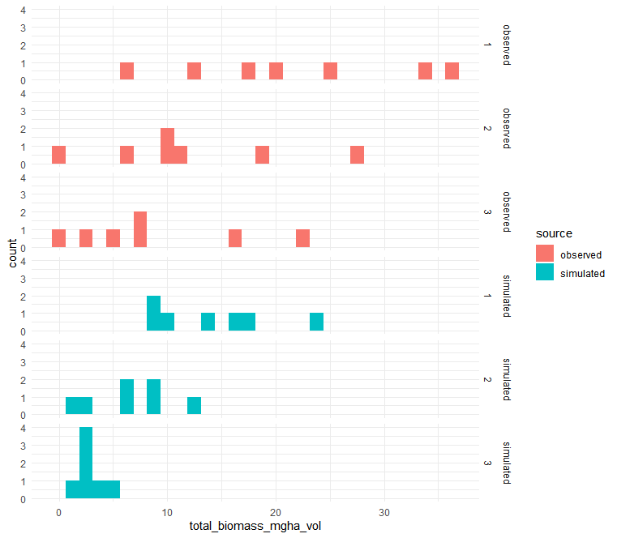
Understory veg reality check

Slide 12
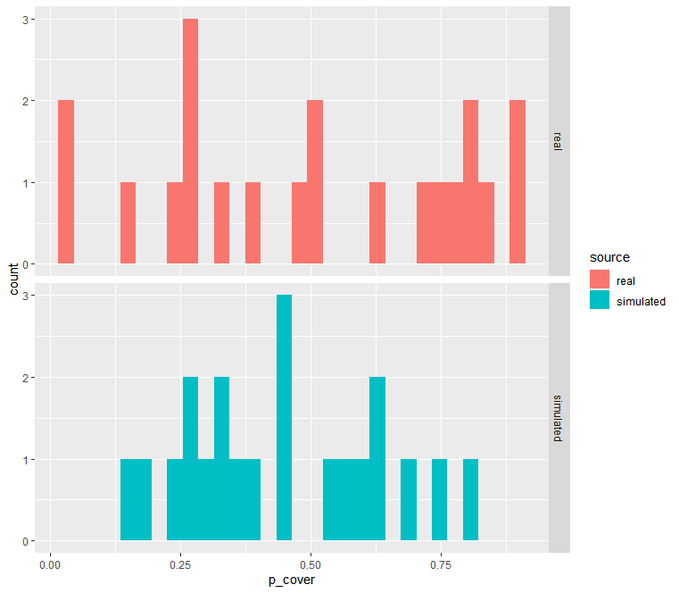
Understory veg reality check

Slide 13
Trees and saplings model description
Neg. Binomial response
  # of trees in plot
Fixed effects
  Drought mortality level
Simulate total count of trees from a NB with mean scaled to plot size
Assign random locations within the simulation space
Use Jenkins equations to get biomass in stem, bark, foliage
  And branches = total – stem – bark – foliage
Use allometric equations to estimate crown radius, voxelize using assumption of conical stem, conical/cylindrical crown

